Slide 1

Love and a Holy Kiss
Chapter 16:1 – 16
10 November 2021
Week 33

Slide 2

Romans 15:14 – 33
Overview . . .
In this last chapter, Paul closes with miscellaneous instructions, greetings, warnings, and a doxology. Of particular note are his comments concerning Phoebe, a servant of the church in Cenchrea (1-2).
Also, his greetings to Priscilla and Aquila remind us of how instrumental this couple was in the spread of the gospel (3-5a). The remaining greetings from Paul remind us that there were many others who contributed to the growth of the church in the first century (5b-16).

Slide 3
Romans 15:14 – 33
Overview . . .
A final warning is given against those who would cause divisions and occasions of stumbling contrary to what Paul had taught in this epistle (17-18). For above all else, Paul wanted to ensure their continued obedience in the gospel (19-20).
Paul’s companions at Corinth add their greetings (21-24), and Paul closes this wonderful epistle with an expression of praise to God for the revelation of the gospel which was leading to the obedience of faith among all nations (25-27).

Slide 4

Tonight’s focus . . .
“Love and a Holy Kiss”

Slide 5
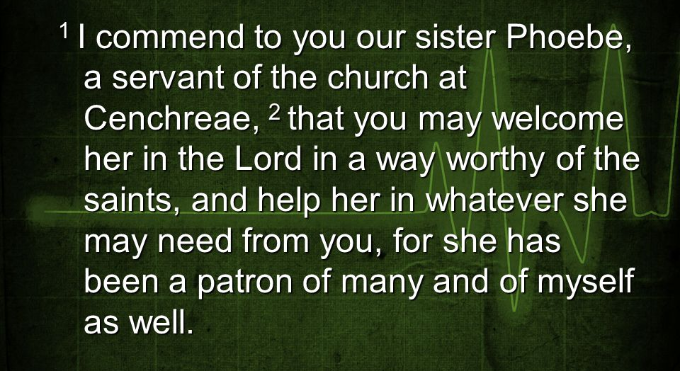
Romans 16:1 – 2

Slide 6
Romans 16:1 – 2
Phoebe (means “pure, bright, radiant”) was Paul’s emissary to deliver this letter, so he wrote officially, I commend to you “our sister” Phoebe, an obvious spiritual reference.
Phoebe served the church in Cenchrea, a seaport a few miles east of Corinth. Phoebe was a servant (diakonos). There is no feminine form of that term in Greek; therefore, the term is taken to mean: deaconess.

Slide 7
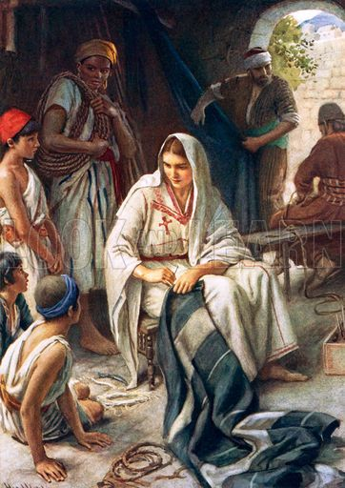
Phoebe

Slide 8
Romans 16:1 – 2
Paul explained, for she has been a great help to many people, including me. So they should help (“stand beside”) Phoebe, just as she had done for Paul and many other people in ministry.
It appears that Paul was asking for something more than routine hospitality. Perhaps Phoebe planned to relocate to Rome or needed help with delicate matters involving the government.
Regardless, Paul thought very highly of Phoebe.

Slide 9
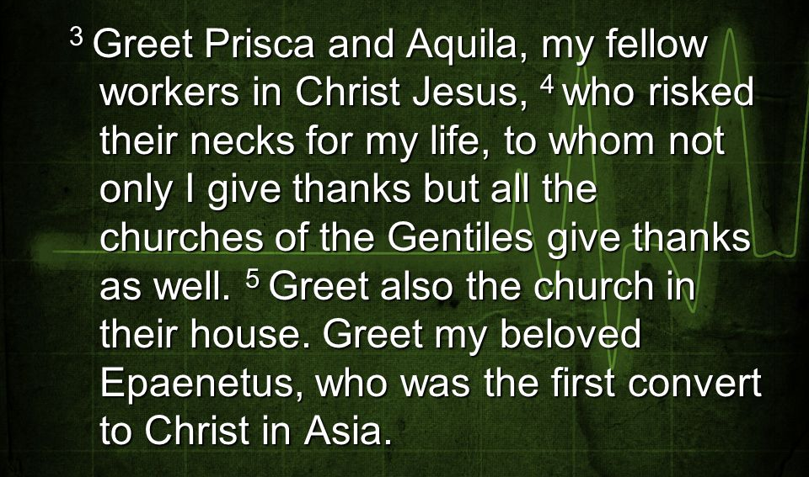
Romans 16:3 -- 5

Slide 10
Romans 16:3 – 5
This list of greetings (3-16) that Paul conveys to friends in Rome is the longest in any of his epistles. He mentioned 26 people by name, and referred to many others (5, 10-11, 13-15).
Several women are included in the list: Priscilla (3), Mary (6), Tryphena and Tryphosa (12), Persis (12), Rufus’ mother (13), and Nereus’ sister (15).
Two others are possibly women—Junias (7) and Julia (15).

Slide 11
Romans 16:3 – 5
Paul first met Priscilla and Aquila when he arrived in Corinth on his second missionary journey (Acts 18:2) and worked with them at their trade of tent-making.
They had come to Corinth from Rome because of Claudius’ decree that all Jews must leave Rome. They accompanied Paul when he left Corinth (Acts 18:18), but stayed in Ephesus when the party stopped briefly (Acts 18:19).
Paul owed his life to the couple, who set aside their own safety (“risked their own necks”) for the sake of their friend Paul.

Slide 12
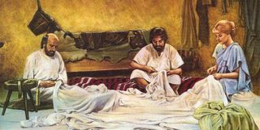
Paul mending a tent with Priscilla and Aquila

Slide 13
Romans 16:3 – 5
While in Ephesus, Priscilla and Aquila ministered to Apollos (Acts 18:26) and undoubtedly to Paul during his stay in Ephesus on his third journey, because they sent greetings to the Corinthian Christians (1Cor. 16:19).
Shortly after that, they must have moved back to Rome and still later returned again to Ephesus (2Tim. 4:19).
Paul also sent greetings to the church that met at Priscilla and Aquila’s house. The Christians in Rome worshiped in numerous homes such theirs.

Slide 14
Romans 16:3 – 5
Epenetus, to whom greetings were sent, is mentioned only here, but is called by Paul my dear friend (“the one loved by me”; cf. Stachys is also called “beloved” in 16:9).
Epenetus was the first convert (“the firstfruits”) to Christ in the province of Asia.
Paul reached Asia, the western portion of modern-day Turkey, on his third missionary journey (Acts 19:10), after having been prevented from going there on his second journey (Acts 16:6).

Slide 15
Romans 16:6 – 7
⁶Greet Mary, who worked very hard for you.
⁷Greet Andronicus and Junias, my fellow Jews who have been in prison with me. They are outstanding among the apostles, and they were in Christ before I was.”

Slide 16
Romans 16:6 – 7
Mary ( a Romanized version of the Hebrew name Mariam) was a Jew who “worked very hard” on behalf (“toiled much”) on behalf of the church. Paul apparently expected the believers in Rome to know the details of her service.
Andronicus and Junias are greeted together. They may have been husband and wife; Junias can be either masculine or feminine. Unfortunately the passage is not clear enough to be helpful in determining. Nevertheless, Paul offers a heartfelt greeting to two people who shared some of his most difficult ordeals and joyous victories in ministry.

Slide 17
Romans 16:6 – 7
Paul calls Andronicus and Junias “my kinsmen,” which probably refers to a tribal relationship and not a family kinship (cf. 9:3). Paul also mentioned four other “relatives” (16:11, 21).
Paul says Andronicus and Junias had been in prison with him (“my fellow prisoners”); when or where this occurred is not mentioned. Paul commends them as outstanding (“having a mark on them”). That is, illustrious, notable, or outstanding among the apostles.
Paul adds, “they came to be and still are” in Christ before I was . . . believers for about 25 years.

Slide 18
Romans 16:8 – 15
⁸Greet Ampliatus, my dear friend in the Lord. ⁹Greet Urbanus, our co-worker in Christ, and my dear friend Stachys. ¹⁰Greet Apelles, whose fidelity to Christ has stood the test. Greet those who belong to the household of Aristobulus. ¹¹Greet Herodion, my fellow Jew. Greet those in the household of Narcissus who are in the Lord. ¹²Greet Tryphena and Tryphosa, those women who work hard in the Lord. Greet my dear friend Persis, another woman who has worked very hard in the Lord. ¹³Greet Rufus, chosen in the Lord, and his mother, who has been a mother to me, too. ¹⁴Greet Asyncritus, Phlegon, Hermes, Patrobas, Hermas and the other brothers and sisters with them. ¹⁵Greet Philologus, Julia, Nereus and his sister, and Olympas and all the Lord’s people who are with them.

Slide 19
Romans 16:8 – 15
The next twenty names offer very little information. Each of the apostle’s comments is like the tip of a narrative iceberg: “beloved,” “fellow worker,” “approved in Christ,” “kinsman,” “worker in the Lord,” “a choice man,” “brethren,” “saints.”
We can only imagine what stories each remark could introduce. All we know for certain is that each name brought to mind a relationship the apostle cherished and shared in common with the church in Rome.

Slide 20
Romans 16:8 – 15
The five names mentioned together in16:14 evidently had something in common, perhaps as leaders of another house church. This may be indicated by the reference to the brothers with them. They are all common names, particularly among slaves. And finally, greetings were sent to Olympas and all the saints with him. This group may have been the leaders of another house church.
Of all these individuals only Priscilla and Aquila are mentioned elsewhere in the NT for certain; yet Paul knew them all individually and sent personal greetings to them and their associates.

Slide 21
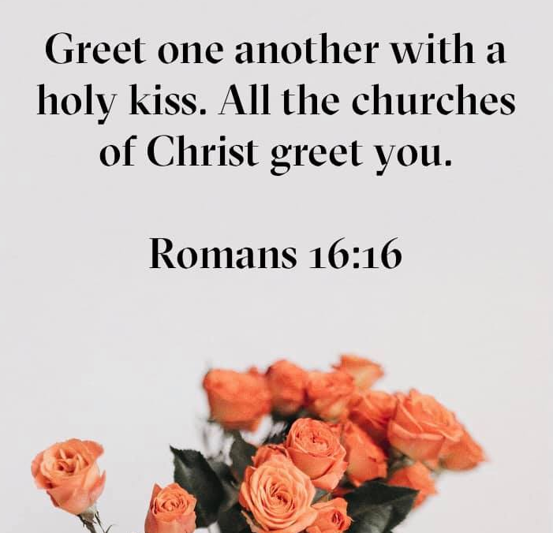
Romans 16:16

Slide 22
Romans 16:16
Paul cannot never be charged with not being “a people person.” After commending Phoebe and greeting his many friends in Rome, Paul closes this section with the command encouraging them to greet one another with a “holy kiss.”
A holy kiss was not an uncommon request of Paul. It was the mode of salutation similar to the handshake today (cf. 1Cor 16:20; 1Thes 5:26).
Paul closes with a general word of salutation, All the churches of Christ salute you (“greet you”).

Slide 23
Romans 16:8 – 15
Romans 16:16 is all about connection. Individuals are united meaningfully “in Christ,” and congregations share that same bond.
People crave meaningful connection with others as much today as two thousand years ago. This is not to suggest that we should revive an antiquated custom or contrive a new one. However, we must find ways to accomplish the purpose of the “holy kiss.”

Slide 24
Application:
Romans 16:1 – 16

Slide 25
Romans: The ABCs of Authentic Affection
  Paul and his companions in Rome didn’t share a lukewarm love. The hardships and victories of ministry had bond their hearts together in a deep, abiding affection that neither time nor distance could diminish.
  Swindoll offers four simple commands to help us remember and apply the lessons Paul taught in this letter 12:1 thru 15:13.
  Think of them as the ABCs of love within the body of Christ . . .

Slide 26
Romans: The ABCs of Authentic Affection
[A] – Accept one another.
  Accept variety. Not only did God create people with diverse appearance, He gave us a broad range of opinions, values, interests, gifts, and abilities. Some think, eat, breathe, and dream missions.
  Others cannot imagine devoting themselves to anyone other than special-need children. Still others are wonderful conduits of music. We need them all.
  Moreover, we are a community of Christians at varying stages of growth and growing at different rates. We have brand-new Christians who still cuss (and some older ones trying to hide it).

Slide 27
Romans: The ABCs of Authentic Affection
[A] – Accept one another.
  We have people who’ve been in the church all their lives and many who are still discovering what life in the body is all about.
  We’re a diverse family, not a collection of clones. Rejoice in variety, and accept – “receive unto yourself” – those who are not like you.

Slide 28
Romans: The ABCs of Authentic Affection
[B] – Become a servant.
  Communities work best when we serve one another. Find something that needs doing or someone who needs help and don’t hold back.
  If you aren’t sure where to begin, find someone who’s been around awhile and ask, “What can I do to help around here?”
  If you want to see a pastor faint, walk up and ask him. Most people want to find only the best fit for their gifts or the precise place to exercise their gifts without regard for the most pressing needs. Servants aren’t picky.

Slide 29
Romans: The ABCs of Authentic Affection
[C] – Culivate esteem for others.
  The “esteem” means “to show value or worth.” The best way to appreciate the worth of another is to treat him or her as you would a VIP.
  Think of someone you greatly admire. Swindoll, for me, that might be Abraham Lincoln. If this great president were to enter my home, I would behave in a certain manner to express my immense respect for him.

Slide 30
Romans: The ABCs of Authentic Affection
[C] – Culivate esteem for others.
  Because our attitudes tend to follow our actions, I can cultivate esteem for someone I don’t even know by giving him or her the same VIP treatment I would offer Lincoln.
  Cultivating esteem for some people will be easier than for others. Let me encourage you to concentrate on giving VIP treatment to those you might ordinarily avoid.

Slide 31
Romans: The ABCs of Authentic Affection
[D] – Demonstrate your love.
  Love without deeds is no better than cold indifference. It feels the same. Therefore, find ways to demonstrate love through acts of kindness.
  And if you’re really up for a challenge, try expressing your love in a more tangible way. Men find this difficult, but we have to get over it.
  Take a few moments to review the ABCs of authentic affection. Then close your eyes and imagine the people in your church faithfully carrying out these four commands … who wouldn’t want to be a part of something that contagious?

Slide 32
Romans: The ABCs of Authentic Affection
[D] – Demonstrate your love.
  People accepting one another without judgment.
  Individuals serving one another without pride.
  Folks treating one another like VIPs.
  Christians freely expressing heartfelt fondness for one another.
  You’d have to shut off the lights and lock the doors to make them go home!

Slide 33

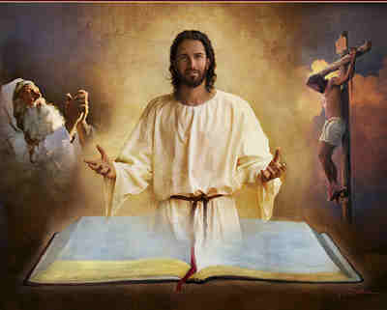
Love everybody …
greet believers with a holy kiss.

Slide 34
NEXT CLASS – 17November 2021
Book of Romans
Before next class, read the below chapter in the KJV and in one other versions of the Bible, i.e., NKJV, NRSV, NIV, CEV, etc . . .
Read Chapter 16:1 – 27
2nd lesson: v17 – 27 “Trouble Makers and Blessed Saints within the Vineyard”

